Slide 1
Analyzing segregation in Santiago, Chile
How economic activities and venues change moving from high-income neighborhoods to low-income ones using the subway route.

Slide 2
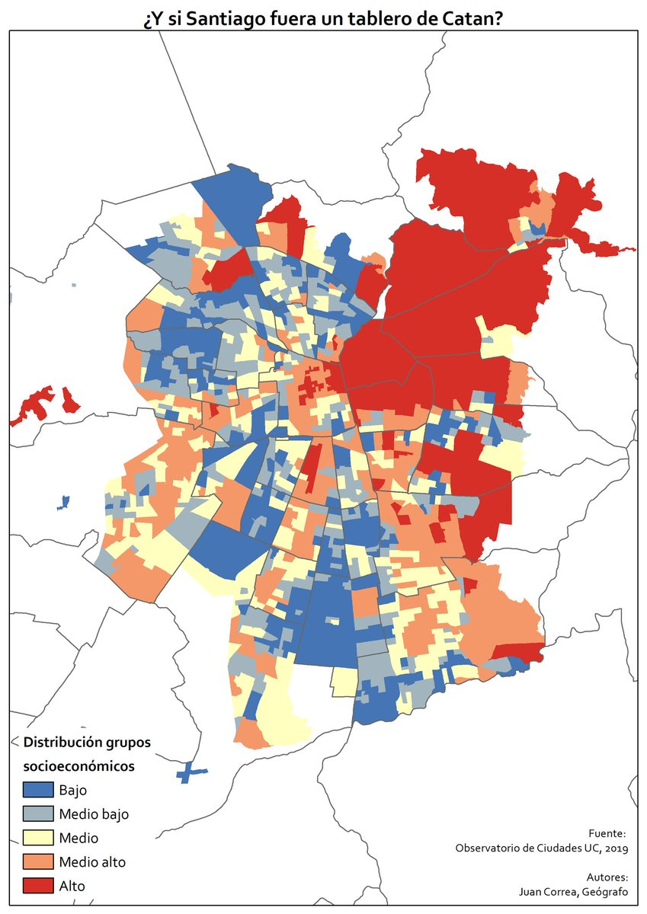
Clusters as a method to categorize activities near subway stations
It’s well-know that Santiago, Chile’s capital, it’s a segregated city, as it can be noticed in the map on the right.
Santiago subway stations are distributed by different routes. To the scope of this problem, we’re going to use the “Linea 1” route because this one covers both high and low socioeconomic sectors.
Socioeconomic
Distribution
Low
Low – Med
Med
Med – High
High

Slide 3
Data acquisition and cleaning
Subway stations names where extracted by hand due to lack of consolidated information online.
Latitude and longitude of stations where extracted using the Geopy package.
Cleaned dataset consists on 27 subway stations, and the data used to the clustering process have +250 features, mostly dummy variables

Slide 4
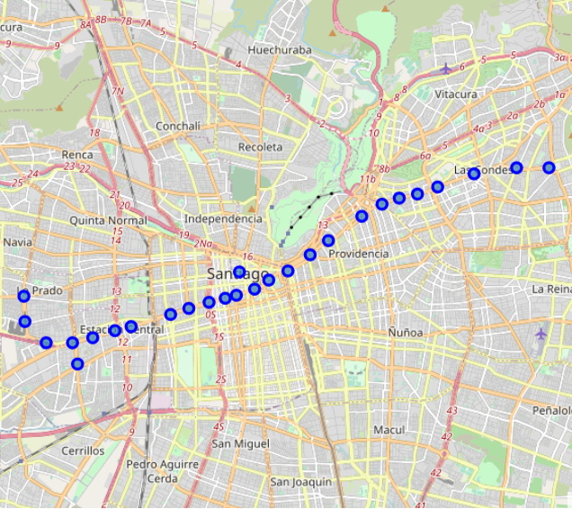
Distribution of subway stations
Clear and defined route from high to low socioeconomic zones.
Low amount of stations analyzed forces us to define small number of clusters. This works to the purposes of the project.

Slide 5
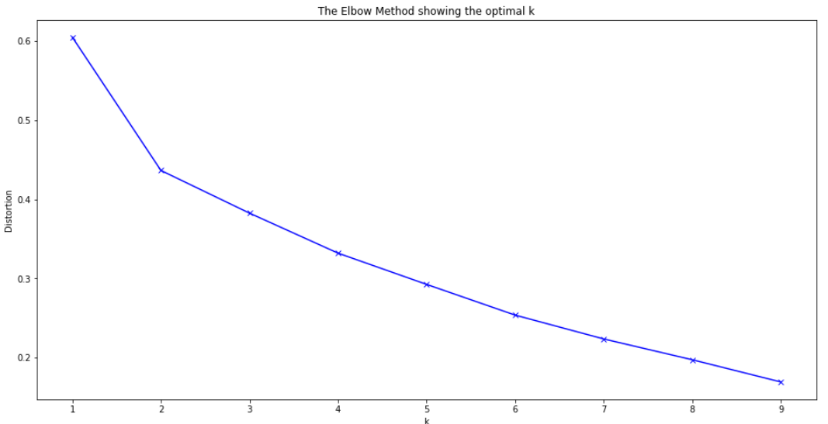
Elbow method to find the number of clusters
After the use of two clusters, the decrease of distortion get smaller
This is consistent with our previous statement
N° Clusters = 2

Slide 6
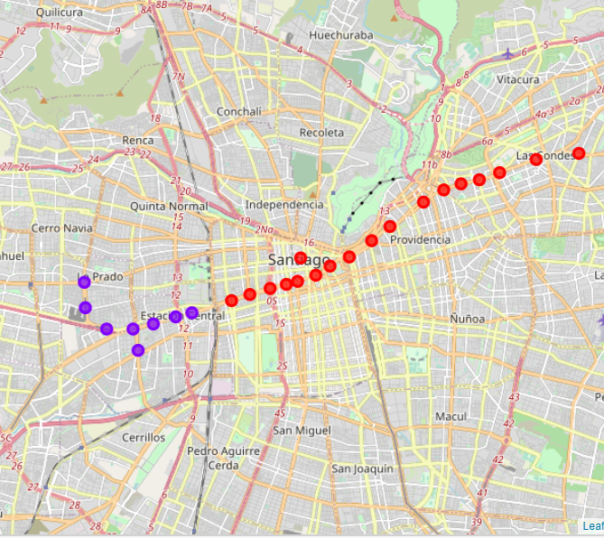
Results and Conclusions
Clearly defined geographic separation
Red Cluster: Coffee Shops, Hotels, Sushi restaurants. Geographic sector: business district and high-income families.
Purple Cluster: Pharmacies, Fast Food restaurants, Sushi restaurants. Geographic sector: small businesses and low-income families
“Sushi it’s really popular in Chile, that’s why it appear in both clusters.

